Slide 1
Introduction to Dialogflow.
Formerly known as API.AI

Slide 2
Content
What is Dialogflow and how a chatbot works.
Connecting to Facebook Messenger and have conversations with the Chatbot.
FAQ Train and Test ChatBot.
Supersmart bot with rich messages.
Chatbot Connecting to 3rd part API.
Save and Retrieve information from a database with the ChatBot.
Recap and Conclusion.

Slide 3




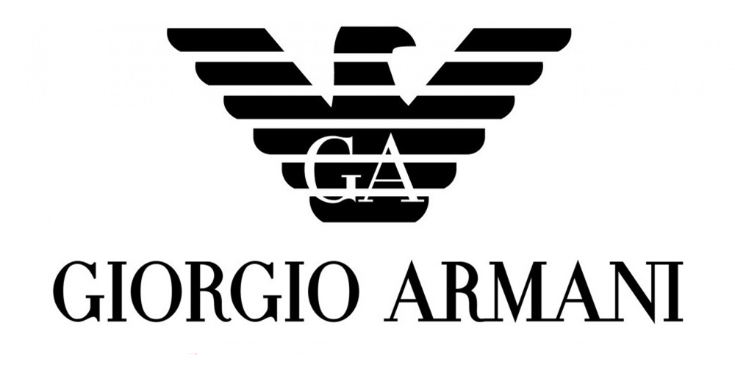
1. What is Dialogflow.
Build natural and rich conversational experiences.
Use machine learning to understand what users are saying.
Reach more audiences, wherever they are
See who's using Dialogflow
Notes:
Build natural and rich conversational experiences –
Give users new ways to interact with your product by building engaging voice and text-based conversational interfaces powered by AI. Connect with users on the Google Assistant, Amazon Alexa, Facebook Messenger, and other popular platforms and devices.
Use machine learning to understand what users are saying –
Provide us with examples of what a user might say when interacting with your product. Using years of domain knowledge and natural language understanding, we analyze and understand the user's intent to help you respond in the most useful way.
Reach more audiences, wherever they are –
Dialogflow is backed by Google and runs on Google infrastructure, which means you can scale to millions of users.
<number>

Slide 4
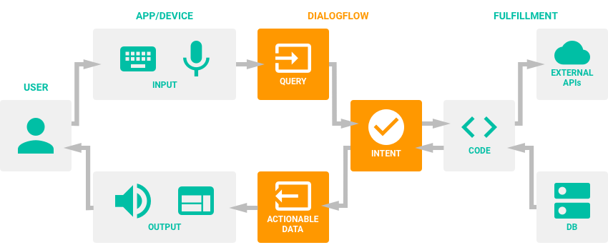
Dialogflow architecture

Slide 5
2. Connecting to Facebook Messenger and have conversations with the Chatbot.
A Facebook messenger bot needs a Facebook page for it to work.
Facebook developer account and Dialogflow Account.
Create a new app in Facebook developer console.
Create an Agent in Dialogflow console.
Enable Facebook messenger on agent integrations.
Notes:
<number>

Slide 6
Dialogflow console
Agent – This is the bot engine for our app.
( SmartBot )
Intent – Intents map the actions in app. Scenarios.
Action - Corresponds to the step our app takes for specific intent. i.e. Intents trigger actions. Can have parameters to extract user information.
More user expressions on an intent means more knowledge bot has when sending a response.
Notes:
Action - Corresponds to the step our app takes for specific intent. i.e. Intents trigger actions. Can have parameters to extract user information.
<number>

Slide 7
3. Training the Bot to identify user questions.
Sometimes, when the number of intents increase, Bot engine will not provide the relevant response.
Instead, It will provide responses like ‘Come again’ , ‘I did not get that’ , ‘Can you say that again’ or it will provide a response that is irrelevant of the context.
To overcome these issues, user expressions can be manually assigned to relevant intents and train them to answer accordingly.
Notes:
Training bot to answer unknown user expressions and making them add to relevant intent in training tab.
<number>

Slide 8
Conversations with the ChatBot
Up until this point, The chat bot only answers one to one questions.
Bot does not have a memory of previous chats in the session.
Entities - Objects that are often specific to a domain as a means of mapping natural language phrases to canonical phrases that capture their meaning.
Quick Replies – Facebook messenger provides easier ways to get user responses to a prompt.
Notes:
Think of entities as a helper for intents. This tells dialogflow the words it should watch for and remember.
Quick replies are available within fulfilment in dialogflow json response.
<number>

Slide 9
Building up a conversation
Context – Defines what the user and the Bot engine have been speaking about.
Contexts link previous messages to current ones. Without defining a context, each chat message will be isolated from ones before it.
Intents in the agent must be designed to follow each other during a conversation.
By default, contexts expire after either five requests or ten minutes from the time they were activated. Intents that renew the context will reset the counter and clock to give an additional five requests and ten minutes.
Notes:
Context example - if a user is listening to music and finds a band that catches their interest, they might say something like: “I want to hear more of them”.
<number>

Slide 10
Parameters and Prompts
Parameters can be defined within the context to get and store user information.
These parameters are linked with system entities or custom entities.
Associated values within the parameters can be used within the response to user.
Prompts are defined if user fails to give mandatory information.
Notes:
If more than one card is used facebook will show them as a carousel. (Rich content)
JSON sent , should match messenger json structure or the json structure of our own api.
Messenger json structure is found in dev.facebook
Messenger will only allow 3 buttons max in rich content.
<number>

Slide 11
Rich message content
Allows responses in text, voice, cards or custom payloads.
Facebook messenger will only allow max 3 buttons for custom payloads.
{ "facebook": {
"attachment": {
"type": "template",
"payload": {
"template_type":"generic",
"elements":[
{ "title":"Welcome to Gift Shop", "image_url":"http://pigeoncenter.org/inc/uploads/2016/08/vegan-gifts.jpg",
"subtitle":"Sent using custom payloads",
"default_action": {
"type": "web_url",
"url": "https://www.amazon.com/",
"messenger_extensions": false,
"webview_height_ratio": "FULL"
},
"buttons":[
{ "type":"phone_number",
"title": "Call shop now",
"payload": "012345679"
}]
} ] } } }}

Slide 12
Knowledge packages and Pre-built agents
Domain packages contain knowledge in each domain which can be injected to a chatbot easily.
Small talk package.
Needs extra resources to process and provide the correct response.
Note that integrating more domains to a single chatbot will result in producing wrong responses.

Slide 13
Follow-up intents
With follow-up intents problems arising with context mismatch and other context related things could be avoided.
Many user expressions , action and context matching are done automatically by Dialogflow.
Follow-up intents can be used with custom payloads other than the given cases.
Intent Priority.
Notes:
There may have some pharses which will match into more than one intent.
Then setting higher priority to an intent will make the phrase call for that intent.
<number>

Slide 14
Code - Walkthrough
Notes:
Message events – Dialogflow does not capture these. It only listens to messages.
Message_deliveries – Callback that occur when message is delivered.
Message_echos – Callback that occurs when a message is sent by a page.
Message_reads – Callback that occurs when a user reads message.
Messages – Receive messages from the user.
Message_postbacks – Occurs when a button or menu is tapped inside a chat.
In the webhook we’ve subscribed to messages and message_postbacks.
<number>

Slide 15
Collect information and send to relevant destination
Send buttons to prompt extra options.
Connecting to 3rd party API and retrieve data to bot.
Access weather services
Obtain API key
Weather intent
Catch intent action in our code
Call API service
Display results.
Store and retrieve data from a database
Notes:
Persistant menu – If user gets lost and wants to start over.
Weather api – openweathermap.org
<number>

Slide 16
Recap and Discussion

